Slide 1
Webcam Fuzz Testing: Testing IoT Deployments
Matthew Elbert
Jeffrey Kitchen

Slide 2
Fuzz Testing (Fuzzing)
Send random inputs to program
Automatable
Cheap
Important for network-facing applications

Slide 3
Why IP Cameras?
Highly available Internet of Things (IoT) deployments
Support many network protocols
May not be heavily tested
Not easily updated
Security issue - If fuzzing could impair/disable the cameras

Slide 4
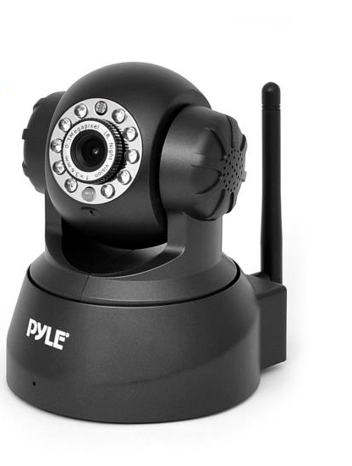
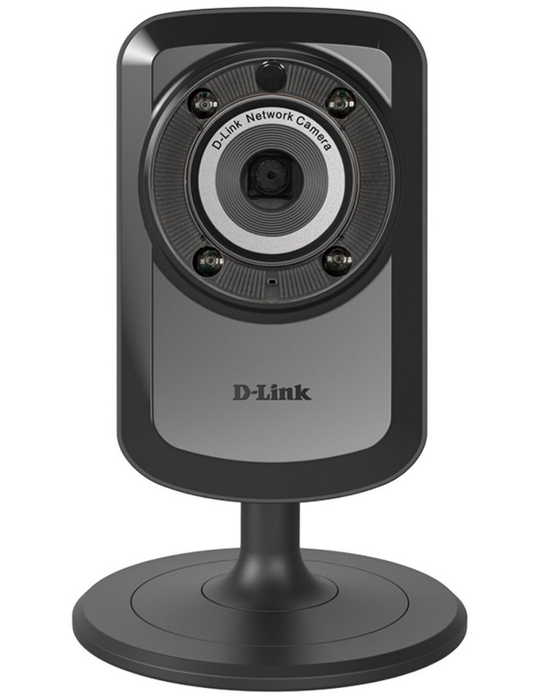
Devices Under Test
D-Link Wireless Day/Night WiFi Network Surveillance Camera
(DCS-934L)
Pyle PIPCAM5 IP Camera Surveillance Security Monitor

Slide 5
Testing HTTP and Web Applications
Advantages
Disadvantages
Widely deployed
Many solutions available
Easy to access
Well understood
Many vulnerabilities found
Widely deployed
Many implementations are hardened from the vulnerabilities found on them

Slide 6
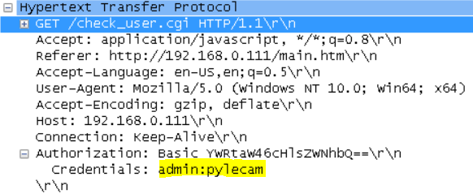
Information Gathering
Wireshark: capture valid traffic from cameras
Found authentication (username:password) in plain text!
Camera web page sources
Found .cgi pages, valid commands
Pyle Cam uses mainly HTTP GET with command codes
Dlink Cam uses mainly HTTP POST with command in packet body

Slide 7
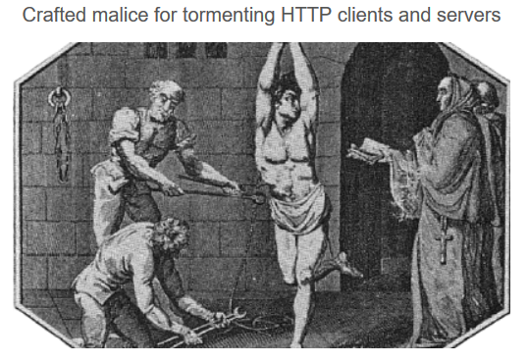
Tool Used: Pathoc http://pathod.net/

Slide 8
Pathoc Examples
Simple command line interface
pathoc hostname request [request ...]
pathoc localhost get:/:b@10:ir,@1
Using script variables
pathoc $ip 'get:@70000,ascii:b@100,ascii:h@10,ascii ’
pathoc $ip 'post:/nightmodecontrol.cgi:b"IRLed='$r'":ir,@5:h“” ’

Slide 9
Bash Script Framework
Script arguments
IP address, Camera ID, Number of tests
Bash variables
Random numbers,
Body and header strings
Authentication credentials
Loops: repeatedly call pathoc with different inputs.
Aggregate and count outputs in log files

Slide 10
Types of Fuzzing
Valid requests with random bytes inserted
Long GET requests (>70,000 byte)
Long headers (>70,000 byte)
POST with random commands
Long post body (>70,000 byte)
GET .cgi commands
Numbers (valid, invalid, large or negative)
Strings of random length

Slide 11
Number of Tests Run
Ran 270,700 tests over one week
Very Time Consuming!
Typically 0.75 – 2.00 seconds per test.
Ran on laptops overnight and on weekends.
Ran on Raspberry PI for 24-hour run.

Slide 12
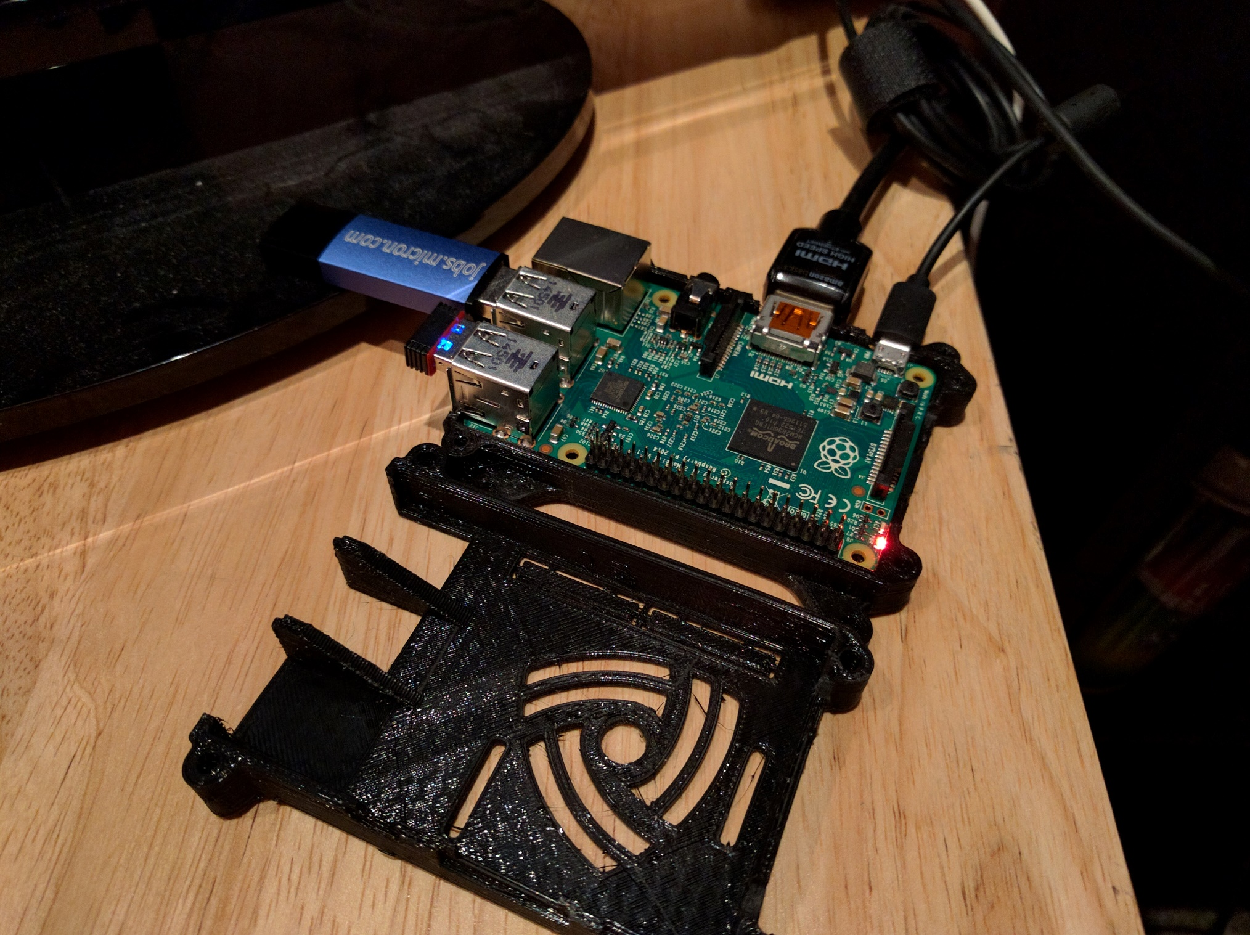

Slide 13
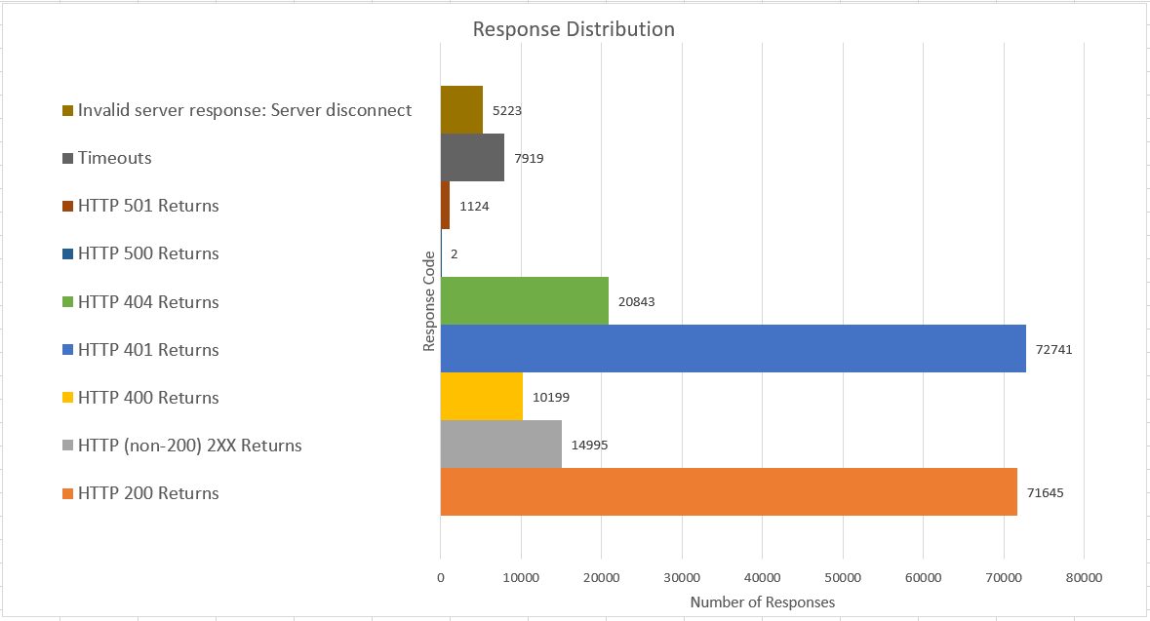
Distribution of Results
(Uncounted) Error connecting to <ip>: [Errno 110] Connection timed out

Slide 14
Conclusions
Cameras seemed pretty solid
No critical or disabling bugs found. Some interesting results:
HTTP 500 – Internal Server Error
Invalid Server Response: server disconnect
Response Timeouts
Connection Timeouts !! May indicate the server went down.
Most troubling vulnerability:
Username & password not encrypted. Attacker could gain full control and disable the device.

Slide 15
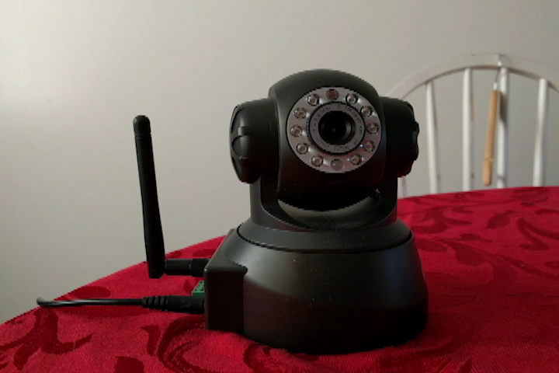

Slide 16
Future Work
Further analysis on root cause of server errors, connection timeouts, etc.
Test the numerous other protocols.
Recognize interesting outputs and repeat/mutate the corresponding inputs.
Use HTTP validator to verify outputs.
Record and evaluate video quality during fuzzing.

Slide 17
Related Work
BANKS, G., COVA, M., FELMETSGER, V., ALMEROTH, K.,
KEMMERER, R., AND VIGNA, G. Snooze: Toward a stateful
network protocol fuzzer. In of Lecture Notes in Computer Science
(2006), Springer, pp. 343–358.
T. KITAGAWA, M. H., AND KONO, K. Aspfuzz: A state-aware
protocol fuzzer based on application-layer protocols. In Computers
and Communications (ISCC), June 2010 IEEE Symposium,
pp. 202–208.
TSANKOV, P., DASHTI, M. T., AND BASIN, D. Secfuzz: Fuzztesting
security protocols. In Proceedings of the 7th International
Workshop on Automation of Software Test (Piscataway, NJ, USA,
2012), AST ’12, IEEE Press, pp. 1–7.

Slide 18
More Related Work- Tools
The Peach Fuzzing Platform
http://www.peachfuzzer.com/
AutoFuzz
http://autofuzz.sourceforge.net/
American Fuzzy Lop
http://lcamtuf.coredump.cx/afl/
Pathod/Pathoc
http://pathod.net/index.html

